Slide 1
Forecast Medical Insurance Prices
MSDS/MSCS 581 - Probability and Statistical Inference
Members – Shourya Thatha Ravi, Rahul Rajesh Singh, Dhruv Patel
December 18, 2022

Slide 2
AGENDA
01 | Introduction
02 | Review of Dataset
03 | Exploratory Data Analysis
04 | Modeling Methodologies
05 | Result Comparison
06 | Best Model Selection
07 | Conclusions

Slide 3
INTRODUCTION

Slide 4


INTRODUCTION
Objective: The goal of this project is to correctly predict/forecast the insurance prices based on the dataset provided.
Importance: Medical insurances play a vital role in improving the health of the society by reducing medical costs incurred, thus facilitating better life quality of individuals.
Motivation: The above said insurances can be ascribed to various features, and thus it is productive to figure out such influential attributes. This also provides a good opportunity for the team to learn techniques and apply regression and ensemble techniques to estimate insurance costs with real-world data.
Dataset: Insurance dataset was provided by Kaggle

Slide 5
REVIEW OF DATASET

Slide 6
REVIEW OF DATASET
CC INSURANCE.csv
The data points cover 1338 individuals across various regions, ages, and several other factors total of 7 variables
Age: age of primary beneficiary
Sex: insurance contractor gender, female, male
BMI: Body mass index, providing an understanding of body, weights that are relatively high or low relative to height, objective index of body weight (kg / m ^ 2) using the ratio of height to weight, ideally 18.5 to 24.9
Children: Number of children covered by health insurance / Number of dependents
Smoker: Smoking
Region: the beneficiary's residential area in the US, northeast, southeast, southwest, northwest.
Charges: Individual medical costs billed by health insurance

Slide 7
EXPLORATORY DATA ANALYSIS

Slide 8
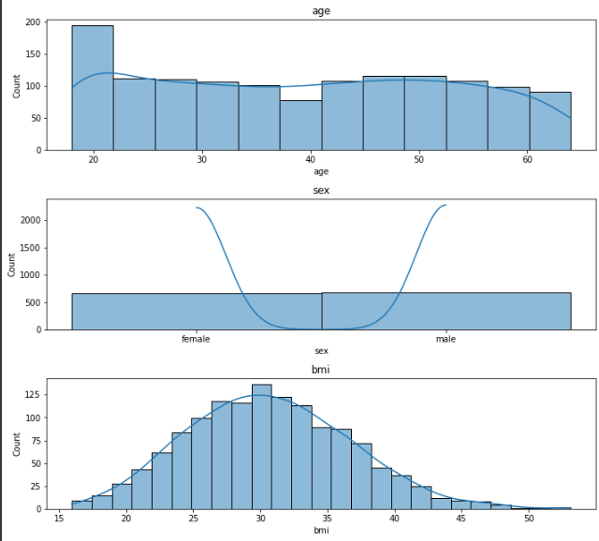
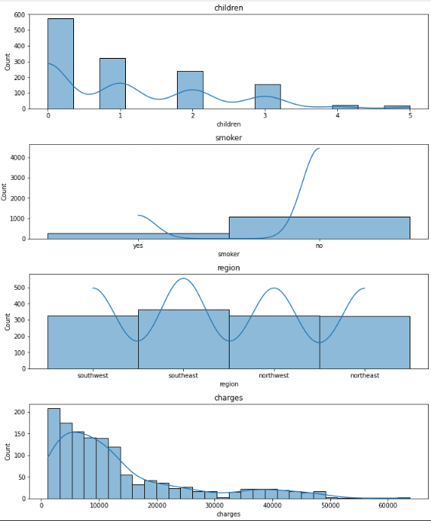
EXPLORATORY DATA ANALYSIS
Distributions of features

Slide 9
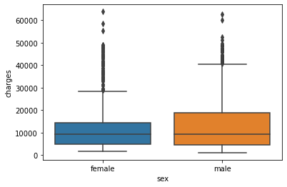
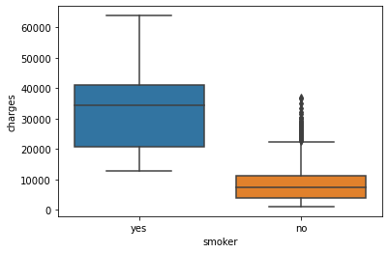
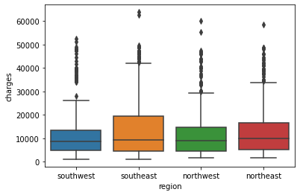
EXPLORATORY DATA ANALYSIS
Almost similar
Almost similar
Huge range and values in general for smokers when compared to non smokers

Slide 10
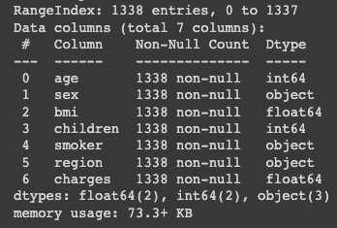
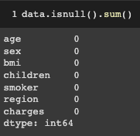
EXPLORATORY DATA ANALYSIS
Data Information
We do not have any missing values. Therefore, we are not imputing any missing values

Slide 11
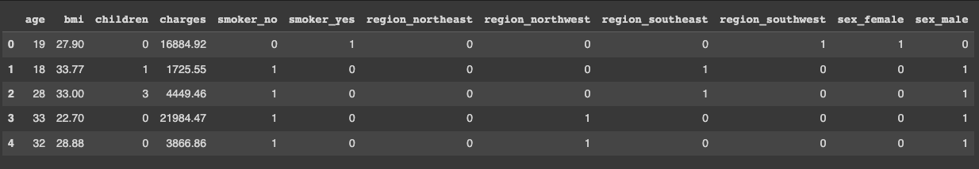
EXPLORATORY DATA ANALYSIS
One Hot Encoding
Using One Hot Encoding to represent the categorical data variables into numeric values enables incorporating them alongside continuous variables in various linear modeling techniques
After they have been encoded, a column from each variable is dropped in favour of the remaining variables, since these are collinear and lead to redundancy.
For example, showing whether a person smokes suffices, instead of implementing for both the cases

Slide 12
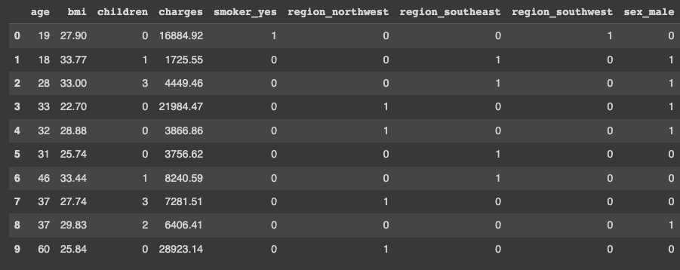
EXPLORATORY DATA ANALYSIS
One Hot Encoding
Dropping smoker_no , region_northeast, sex_female to remove multicollinearity.

Slide 13
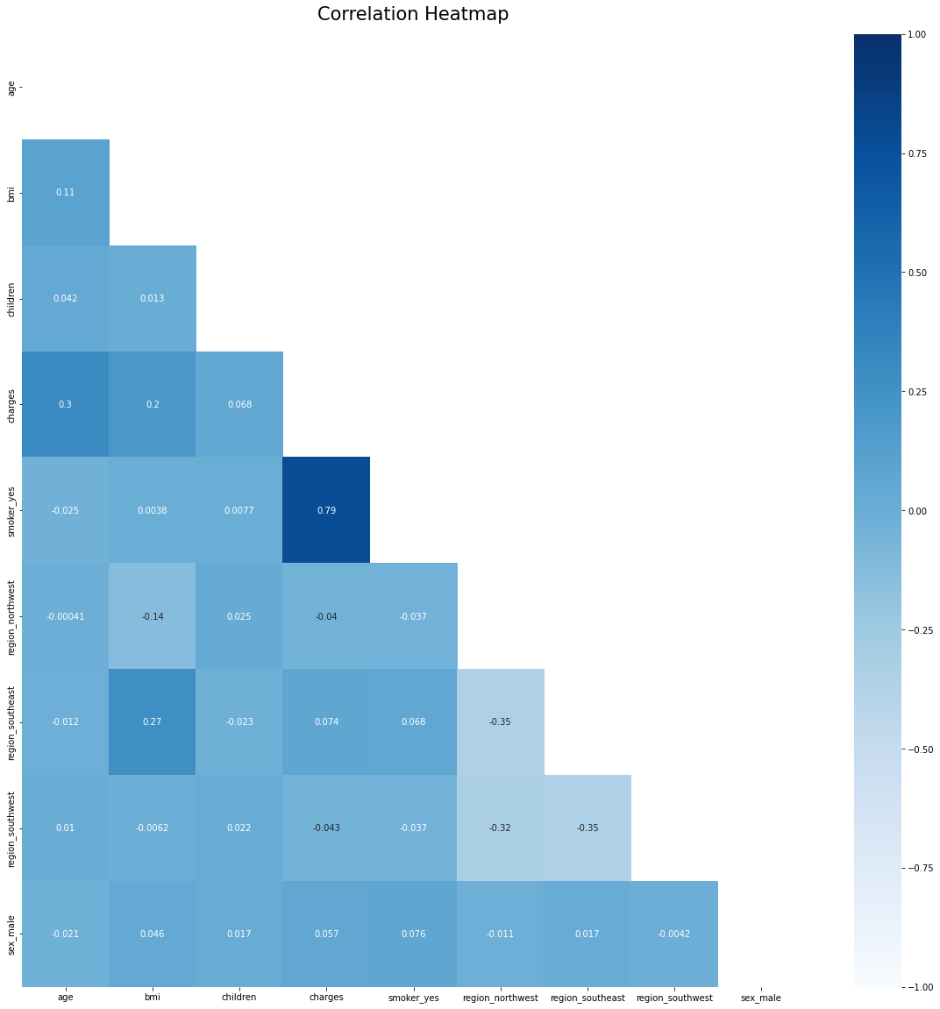
EXPLORATORY DATA ANALYSIS
Correlation Heatmap
Almost no correlation for most of the variables
Smoker_Yes highly correlated with charges i.e. the target variable
The least correlated variables are the region ones, which is intuitive

Slide 14
MODELING METHODOLOGIES

Slide 15

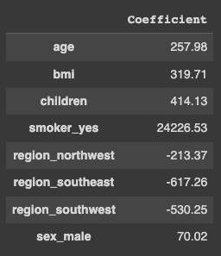
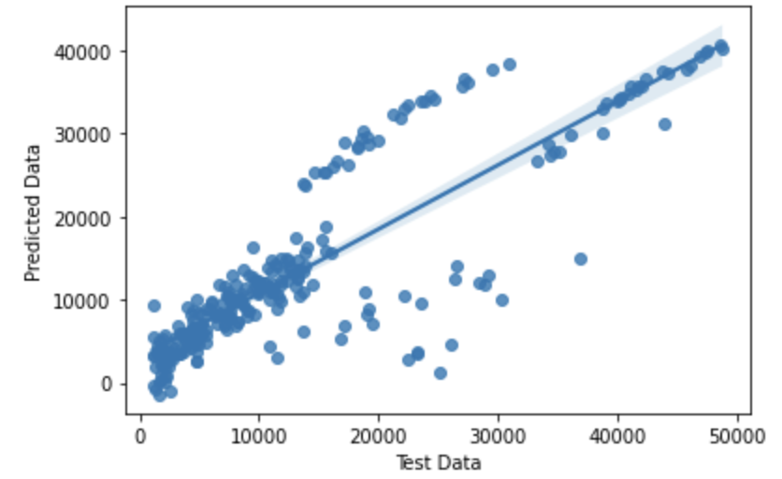
MULTILINEAR REGRESSION

Slide 16
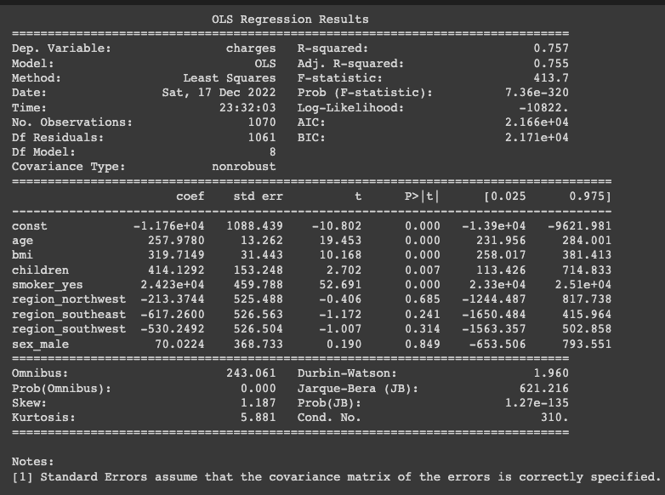
MULTILINEAR REGRESSION
The R Squared and adj. R2 for the linear model are ~0.75
Based on the p values, it can be noted that the regions and sex of an individual are statistically the least/ not significant
Other variables like age, bmi etc. are significant
Low Value of Prob F-Statistic points out that the model in itself is significant
Among the variables, Smoker_yes seems to have the highest coefficient, implying that this binary variable heavily influences our data
The other remaining variables vary positively with the target variable
Summary for the Linear Model related with the data set

Slide 17
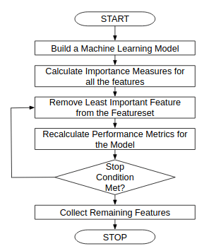
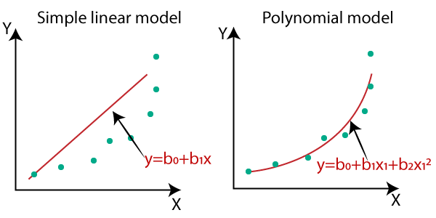
POLYNOMIAL REGRESSION
In attempts to achieve a better model, polynomial regression is implemented after linear regression
Degrees upto 2 is used which yields a model with 45 variables, after all the possible combinations of variables
After which, Recursive Feature Elimination(RFE) is applied as the feature selection model, and a reduced dataset is retrieved
Thus, after applying Linear Regression to this dataset, we achieve polynomial Regression
RFE Flowchart

Slide 18
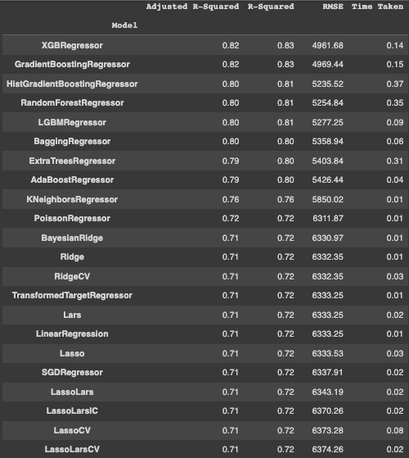
Lazy Regressor:
It is one of the best python libraries that helps you to semi-automate your Machine Learning Task. It builds a lot of basic models without much code and helps understand which models work better without any parameter tuning.
We frequently do not know which models will perform well with the dataset at hand when beginning to work on a supervised learning challenge. Starting with a model (like Random Forest) that performs reasonably well across a wide range of datasets and iterating from there is one potential option.

Slide 19
Best Model Selection:
HyperParameter Tuning using Gridsearch:
A hyperparameter is a particular kind of parameter that is specified before the learning process starts and is external to the model. It is controllable and has a direct impact on how well a model works.
A Grid Search is an exhaustive search over every combination of specified parameter values. If you specify 3 possible values for max_depth and 4 for n_estimators, Grid Search will iterate over 12 possible combinations.
Sometimes tuning our model using our intuition will suffice. Additionally, optimization algorithms like GridSearch and RandomSearch are worthwhile to attempt.
Most RandomizedSearchCV’s parameters are similar to GridSearchCV’s.

Slide 20
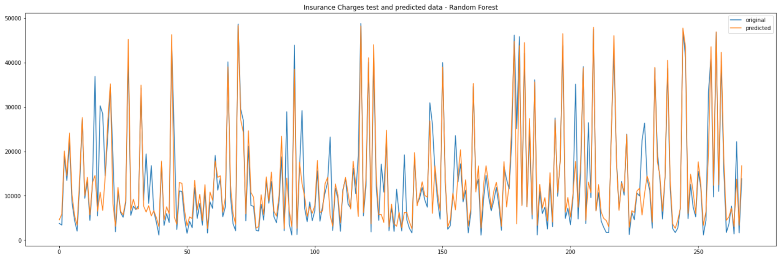
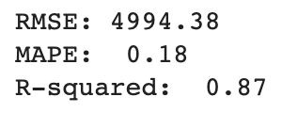
Random Forest Regression:
We used the sklearn module for training our random forest regression model, specifically the Random Forest Regressor function. The Random Forest Regressor documentation shows many different parameters we can select for our model. Some of the important parameters are highlighted below:
n_estimators — the number of decision trees you will be running in the model.
criterion — this variable allows you to select the criterion (loss function) used to determine model outcomes. We can select from loss functions such as mean squared error (MSE) and mean absolute error (MAE). The default value is MSE.
max_depth — this sets the maximum possible depth of each tree.

Slide 21
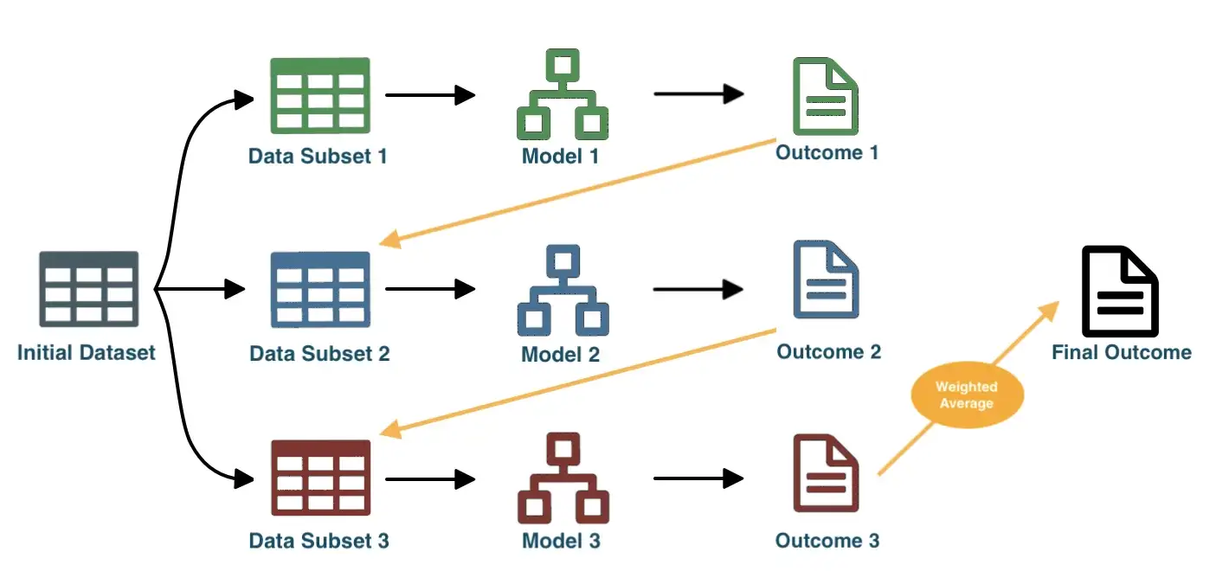
Boosting
Boosting is a sort of ensemble learning where the output from one model is fed into the next.
Boosting trains models sequentially rather than separately, with each new model being trained to fix the flaws of the preceding ones.
The outcomes that were successfully predicted are given a lower weight at each iteration, whereas the ones that were incorrectly forecasted are given a higher weight. It then calculates a final result using a weighted average.

Slide 22
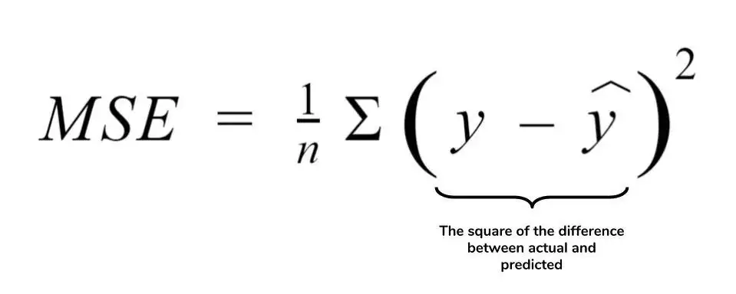
Gradient Boosting
Gradient Boosting is a boosting technique that uses a gradient descent approach to decrease mistakes. Gradient descent is a straightforward iterative optimization approach for reducing a loss function.
The loss function measures how far off from the actual result our forecast is for a particular data point. The output of our loss function will be lower the better the forecasts are.
Our model's construction aims to minimize the loss function over each data point. For instance, the most frequently used loss function for regression is Mean Squared Error (MSE).
Gradient boosting increases the weight of incorrectly anticipated results and modifies those weights according to a gradient, which is determined by the direction in which the loss "decreases the fastest" in the loss function.

Slide 23
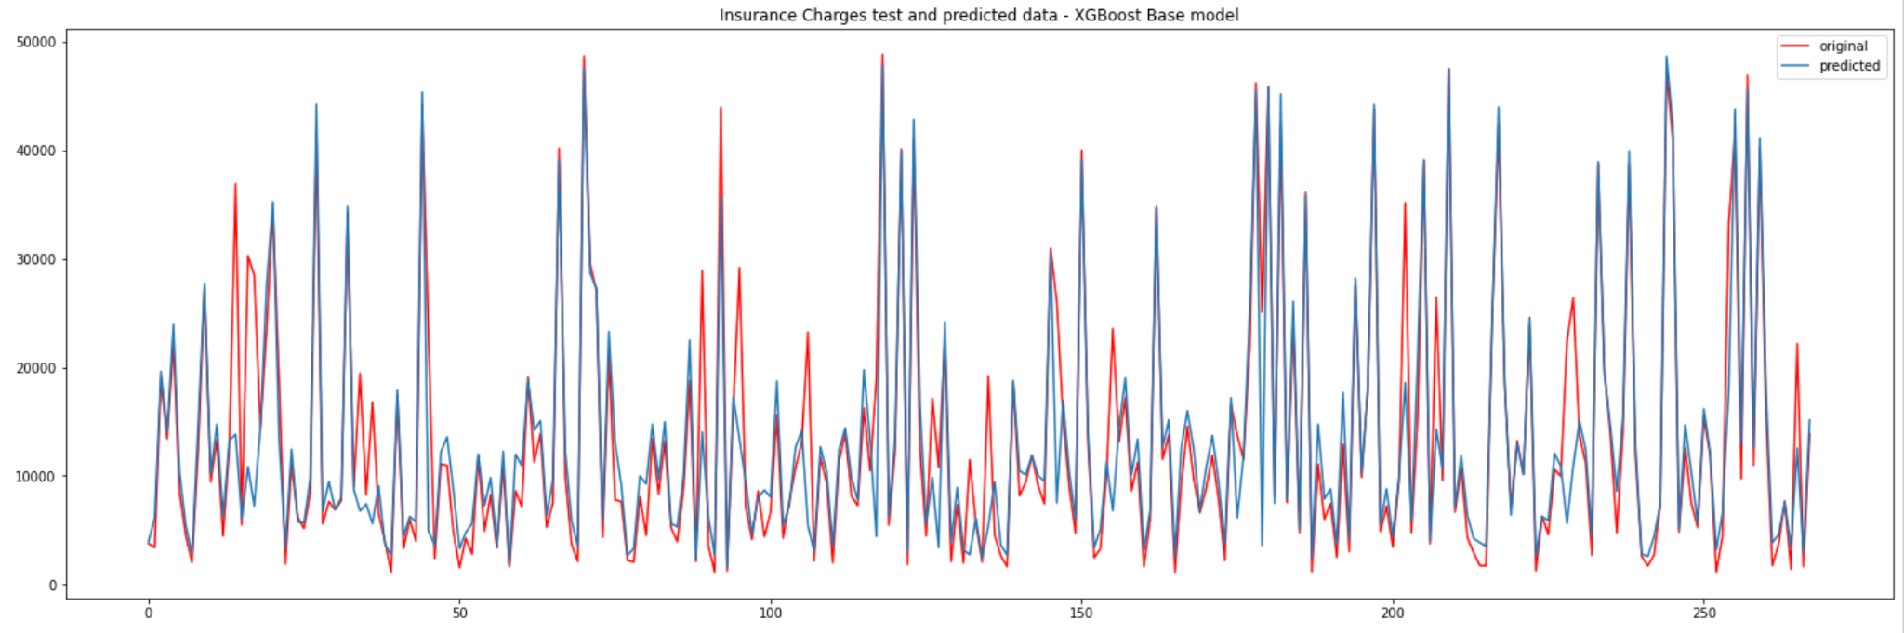
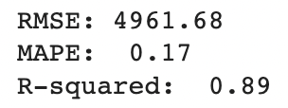
XGBoost:
Extreme Gradient Boosting, or XGBoost, is an improved version of the Gradient Boosting framework. It’s strength comes from the entire underlying system optimization (parallelization, caching, hardware optimization, etc.), not just the method itself.

Slide 24
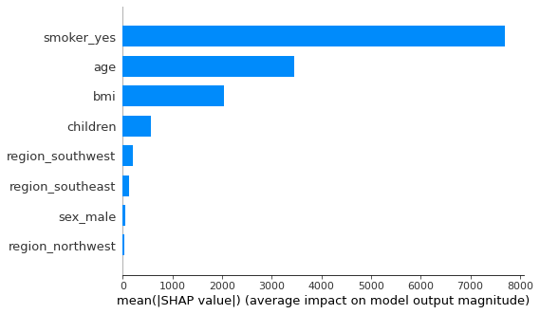
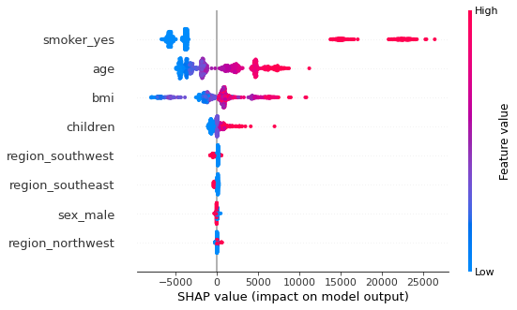
SHAP PLOTS
The above plots are based on SHapley Additive exPlanations (SHAP) which explain the feature importance for the calculated XGBoost Model
As seen in the left bar, Smoking is the feature which affects the insurance costs the most, followed by age and bmi whereas regions and sex are almost insignifcant
The beeswarm plot indicates positive shap value for smoking and negative for not smoking

Slide 25
RESULTS COMPARISON

Slide 26
Results comparison - MAPE, R-squared
Model | RMSE | MAPE | R Squared
Multilinear Regression | 6333.25 | 0.19 | 0.75
Polynomial Regression | 5197.51 | 0.12 | 0.79
Decision Trees | 5284.07 | 0.14 | 0.86
Random Forest | 4994.38 | 0.18 | 0.87
XGBoost | 4961.68 | 0.17 | 0.89
XGBoost using Randomized Search | 5193.12 | 0.13 | 0.91
XGBoost using Grid Search | 5034.57 | 0.19 | 0.88

Slide 27
CONCLUSIONS

Slide 28
CONCLUSIONS:
From the above seen models, we can note that Boosting Models Performed the best, especially XGBoost
Among all the factors, Smoking seems to be the most influential one being positively correlated with insurance charges
It is followed by Age and BMI whereas, surprisingly, the sex of an individual doesn’t contribute much to the costs
Model | RMSE | MAPE | R Squared
XGBoost | 4961.68 | 0.17 | 0.89

Slide 29
THANK YOU

